Slide 1
ELISA TEST Dr. Rana A.Fayez

Slide 2
Enzyme-Linked Immunosorbent Assay (ELISA) is a modern molecular technique for the detection of antigen-antibody interaction with the help of an enzyme.
It is one of the sensitive enzyme immunoassay techniques for the detection of the presence of antigen or antibody and quantification as well in the case of clinical diagnosis of many diseases.
In ELISA utilizes an enzyme system to show a specific combination of an antigen with its antibody. It is a method of quantifying an antigen immobilized on a solid surface. ELISA uses a specific antibody with a covalently coupled enzyme. The amount of antibody that binds the antigen is proportional to the amount of antigen present, which is determined by spectrophotometrically measuring the conversion of a clear substance to a colored product by the coupled enzyme

Slide 3
ELISA technique was first conceptualized and developed by :
Peter Perlmann and Eva Engvall
at Stockholm University, Sweden.

Slide 4
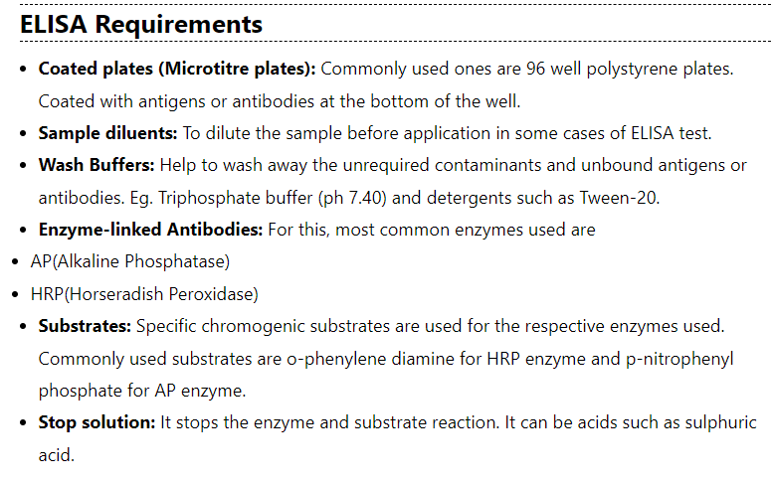

Slide 6
Types of ELISA
They are of mainly four types:
Direct ELISA
Indirect ELISA
Sandwich ELISA
Competitive ELISA

Slide 7
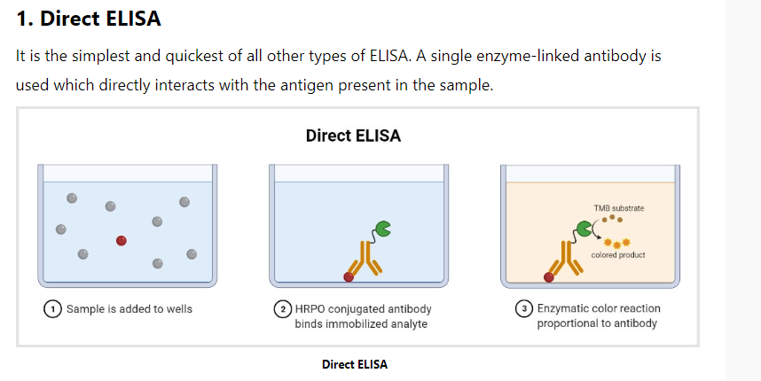

Slide 8
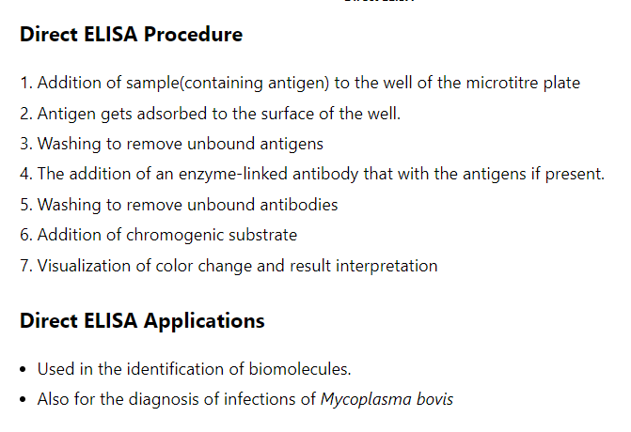

Slide 10
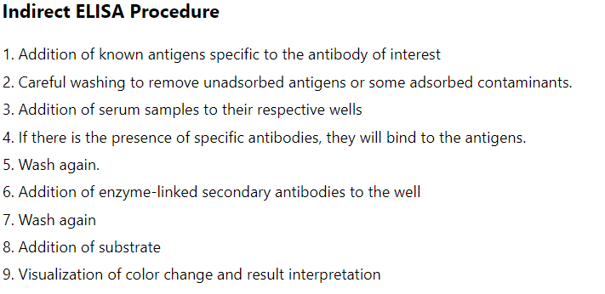

Slide 12
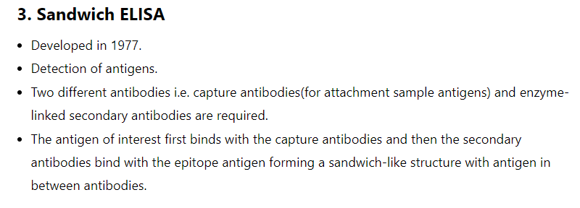

Slide 13
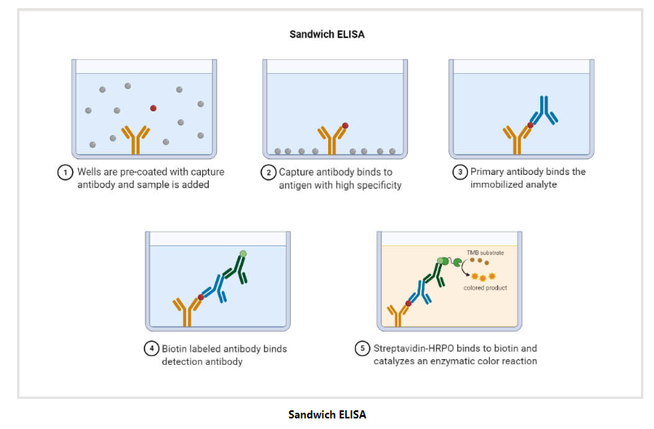

Slide 14
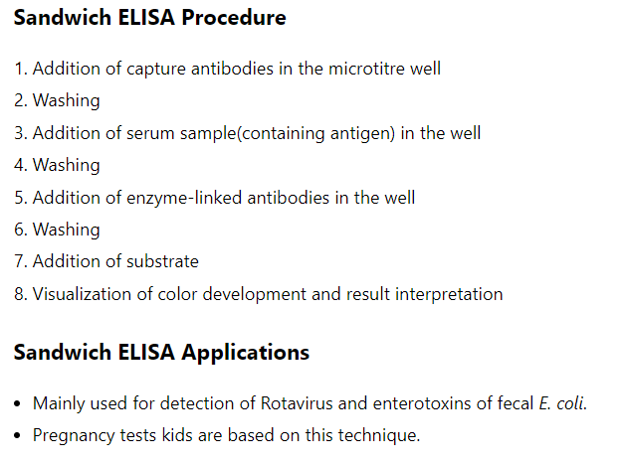

Slide 16
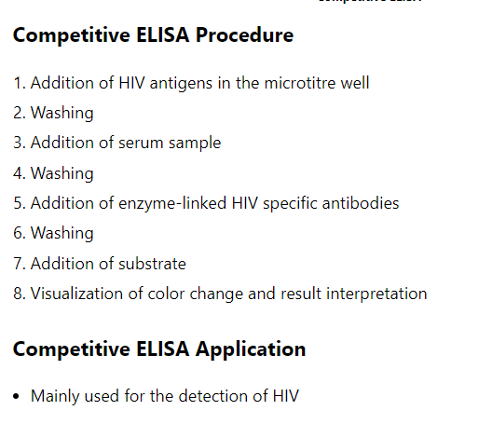

Slide 17
ELISA Result Interpretation
1. Qualitative interpretation i.e. presence or absence of antigen is done by visualizing the color change in the solution.
2. If the Ag-Ab reaction takes place and bound enzyme linked with antibodies remain in the solution, they will modify the substrate, and color change can be seen.
3. Quantitative interpretation i.e. concentration of antigen or antibody can be identified by measuring the optical density of the solution with the help of an ELISA reader spectrophotometer.
4. optical density (vs) concentration curve is prepared for both the standard sample and unknown sample and compared to determine the concentration in the unknown sample.

Slide 18
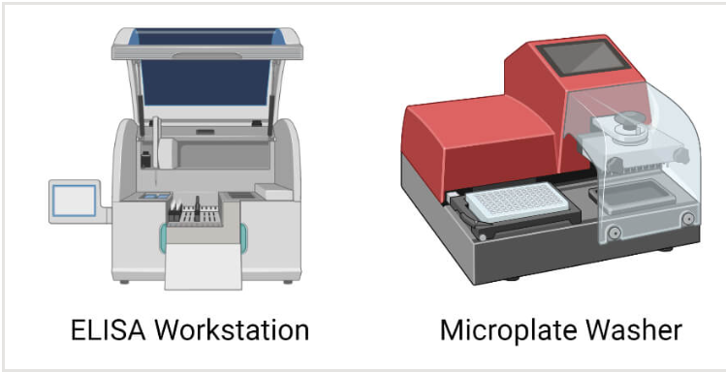

Slide 19
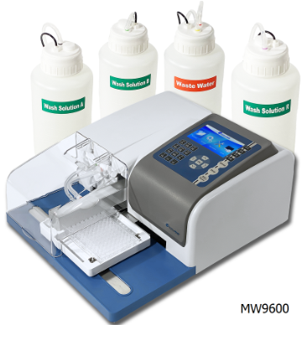
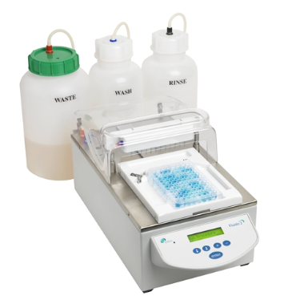
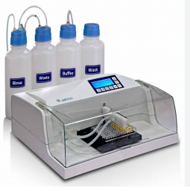
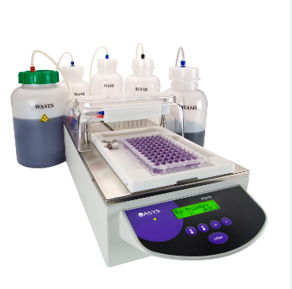

Slide 20
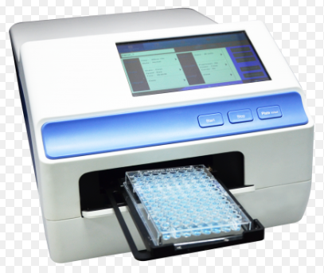
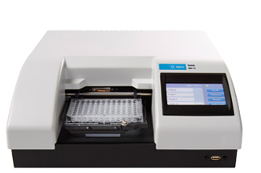

Slide 21
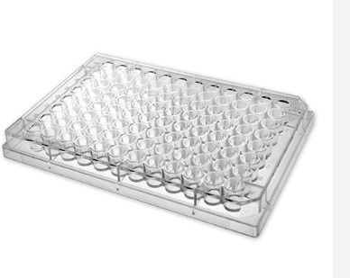
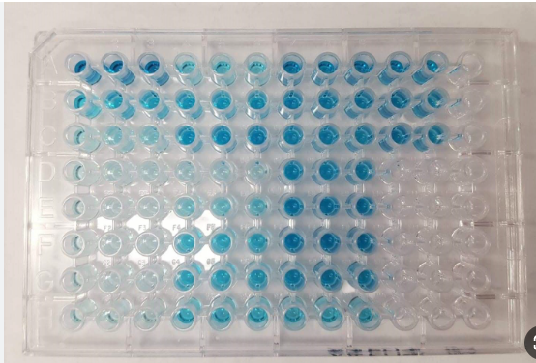
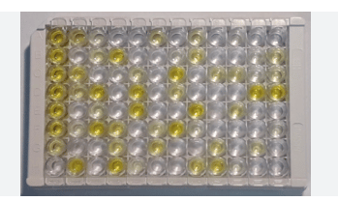

Slide 22
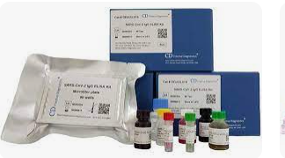

Slide 23
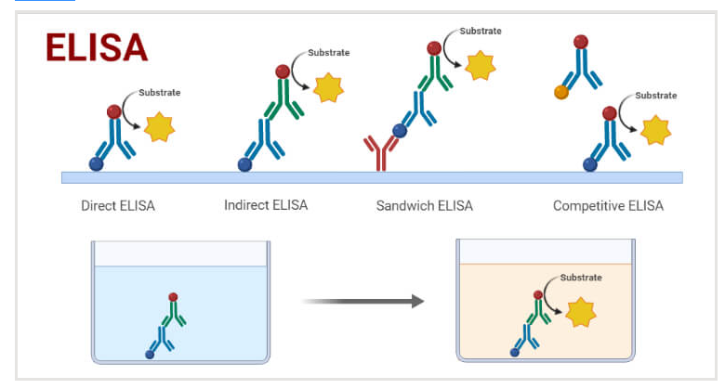

Slide 24
